Slide 1
Aggie Hacks x Google Cloud: COVID 19 Challenge, Path to Recovery
On Vaccine Rollouts
Team Mavericks
Team Members: Michael Harris, Dave Arno, Dhwani Mehta, Niaoniao Ma
Notes:
Title Slide.

Slide 2
Table of Contents
01
02
03
OBJECTIVE
ANALYSIS
CONCLUSION
Problem statement on vaccine adoption and sentiment
Findings, visualizations, and insights by subgroups
Policy recommendations for a speedy recovery
Notes:
The project is split into three main parts, the Problem statement, Our analysis and the Conclusion with next steps.

Slide 3
01
OBJECTIVE
Problem statement on COVID-19 Vaccination Adoption and Sentiment
Notes:
We describe the background and objective of this analysis.

Slide 4
Objective
Setting the Stage
The Problem
Our Goal
As vaccinations have increased over the last several months, general sentiment towards the vaccine has improved; more people have received a vaccine, or have indicated that they are willing to take the vaccine, as time has passed.
Though vaccine sentiment is improving, there still remains an disproportionate number of people who are unwilling to take the vaccine among certain subgroups.
Identify areas with the lowest sentiment for vaccines and examine why this unwillingness to take the vaccine is prevailing. Then, suggest outreach schemes by the government, employers and communities that could increase vaccine adoption.
Notes:
In this slide, we set the stage for our presentation; we will be analyzing vaccine sentiment over time, and identifying subgroups for which unwillingness to take the vaccine remains high. Our goal is to identify these subgroups, the reasons for which they are likely to not take the vaccine, and to prescribe solutions to policymakers, professionals, and employers to increase vaccine adoption.

Slide 5
Why Is This Important?
Arrive at policies to target specific subgroups and influence them to get vaccinated.
Improve vaccine sentiment across the United States.
Ensure that impacted subgroups get vaccinated at higher rates.
COVID-19 response is a national, collaborative effort. Higher vaccination rates will reduce COVID cases and deaths, and will allow for a swift reopening of the country.
Notes:
In this slide, we address why the importance of our project to the government, local communities, & healthcare professionals.

Slide 6
Data Source
Reliability
Continuity
Coverage
Primary data source: Household Pulse Survey Data* by US Census Bureau
Response data from surveys on COVID response disseminated by the US Government
Data collected every 2 weeks for 27 periods, with an average number of periodic respondents of ~70,000*
Comprehensive datasets covering 50 states & D.C with questions on health, employment, education...
Notes:
*Data sources: https://www.census.gov/programs-surveys/household-pulse-survey/datasets.html
*https://www2.census.gov/programs-surveys/demo/technical-documentation/hhp/Phase3_Source_and_Accuracy_Week_27.pdf
Our team utilized the Household pulse survey data that is collected by the United States Census Bureau. In this survey, respondents enter in their characteristics, and answer a series of questions regarding their sentiment on the COVID-19 pandemic, and how their lives have been impacted.
The Census began collecting this survey data in April 2020, shortly after the COVID pandemic became widespread in the United States. Since then, they have been collecting this data biweekly. However, the Census does not consolidate the data files each time that they conduct this survey. There were 27 different CSV files with data collected at different points during the pandemic that our team had to consolidate. Furthermore, while certain questions in every biweekly survey, other questions were added and removed throughout the collection process. For example, questions regarding the COVID Vaccine were added in December 2020 surveys as the vaccine started to become available to the public in the U.S

Slide 7
02
ANALYSIS
Findings, visualizations, and insights by subgroups
Notes:
We move on to the analysis section.

Slide 8
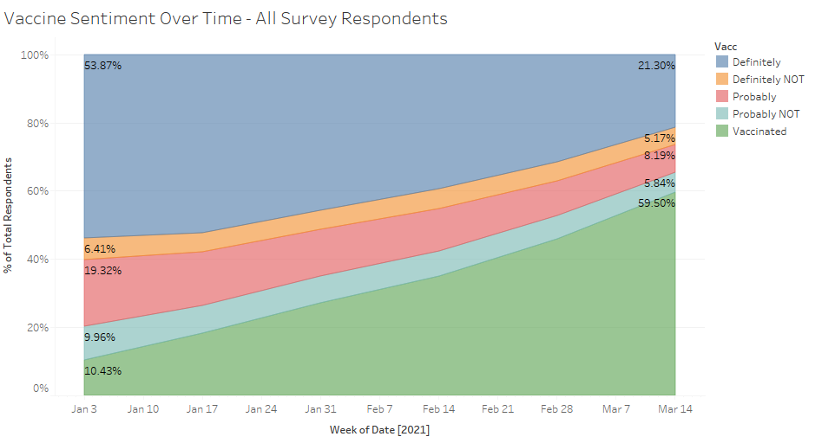
Vaccine Sentiment Has Improved Over Time
Among all survey respondents, we observe an increase in vaccinated respondents, and a decrease in the unwillingness to take the vaccine.
Data Shown from January 1, 2021 to March 29, 2021
Notes:
Above is a area chart showing the percentages of respondents who answered on whether they have been vaccinated or whether they plan on being vaccinated. We can see that the respondents who plan on getting vaccinated drops over time as the number of vaccinated respondents increases; this is because many of those who indicated that they were likely to take the vaccine actually took it. Likewise we see that the number of respondents who do not plan on getting vaccinated does not decline as drastically, showing that there is still a subset of the population that remains unwilling to be vaccinated.

Slide 9
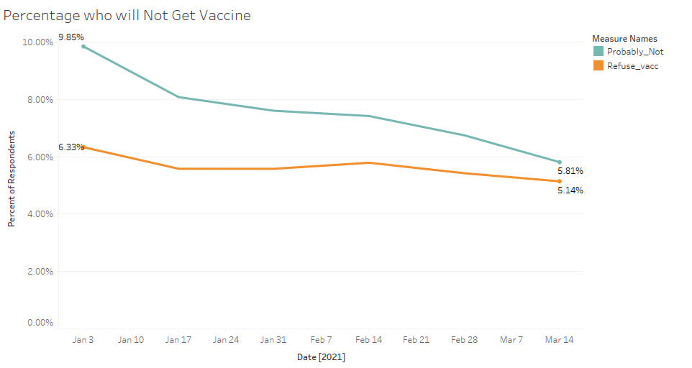
Unwillingness to take a Vaccine Has Declined Over Time
Among all survey respondents, we observe the percentage of those who are likely to not take the vaccine decrease from 16.2% to 10.9% from January to March 2021.
Data Shown from January 1, 2021 to March 29, 2021
Notes:
Visualization showing how the percentage of respondents who are unwilling to take the vaccine has declined over time, from January to March 2021.
We can see that teal represents the response, probably not and orange is Definitely Not. Moving forward we combined both these responses into one grouping.

Slide 10
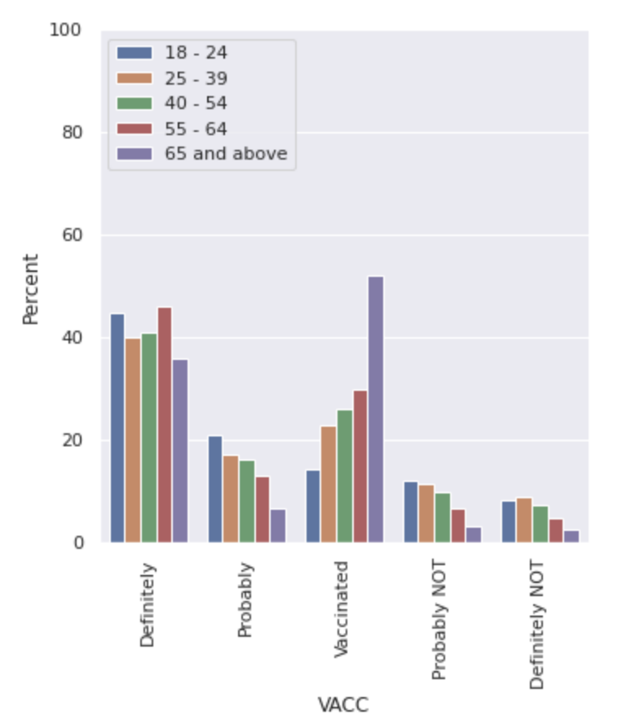
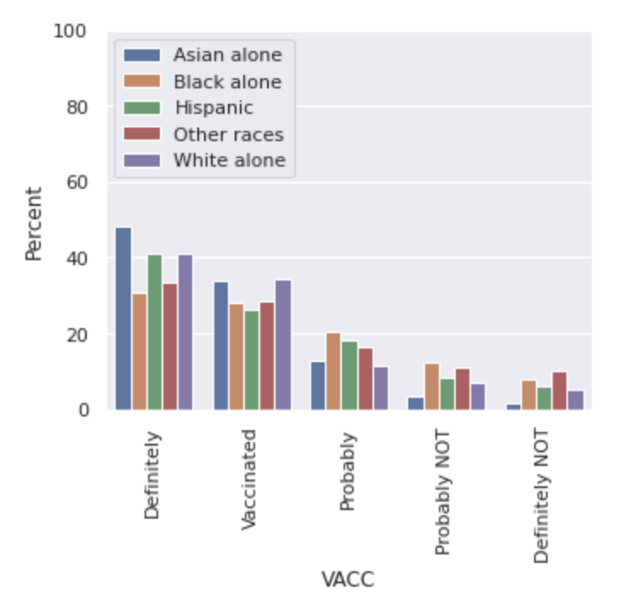
Attitude Towards Vaccination by Age and Ethnicity
Figure 1: Vaccine Sentiment By age
Figure 2 Vaccine Sentiment By Ethnicity
Younger people (ages 18 - 39) and Black and Hispanic Americans are more against taking vaccines that the other groups.
Notes:
We observe that vaccine sentiment differs across subgroups; specifically, by age and ethnicity.

Slide 11
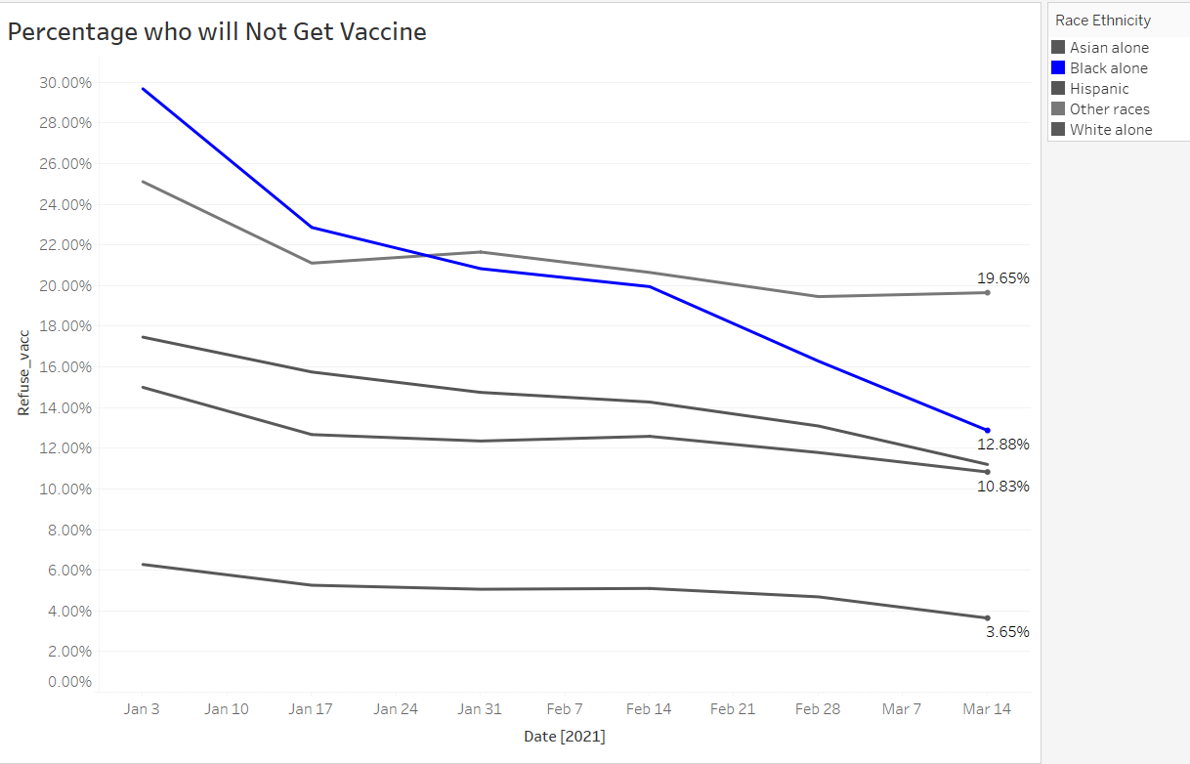
Specifically, Sentiment Among Black Americans Has Changed Most Drastically
Figure: Vaccine Sentiment by Race over time
Distrust in vaccines among Black Americans has changed most drastically over time, moving from ~30% to 12.88% by March 2021.
We infer that this could be the result of the change in the political administration since January and the effectiveness of Biden’s vaccination outreach campaign*.
Notes:
We also observe that distrust in vaccines among Black Americans has changed most drastically over time.
Sources:
https://www.pewresearch.org/fact-tank/2020/10/21/key-facts-about-black-eligible-voters-in-2020-battleground-states/
https://www.nbcnews.com/politics/white-house/biden-administration-formally-launches-national-vaccination-outreach-campaign-n1262236

Slide 12
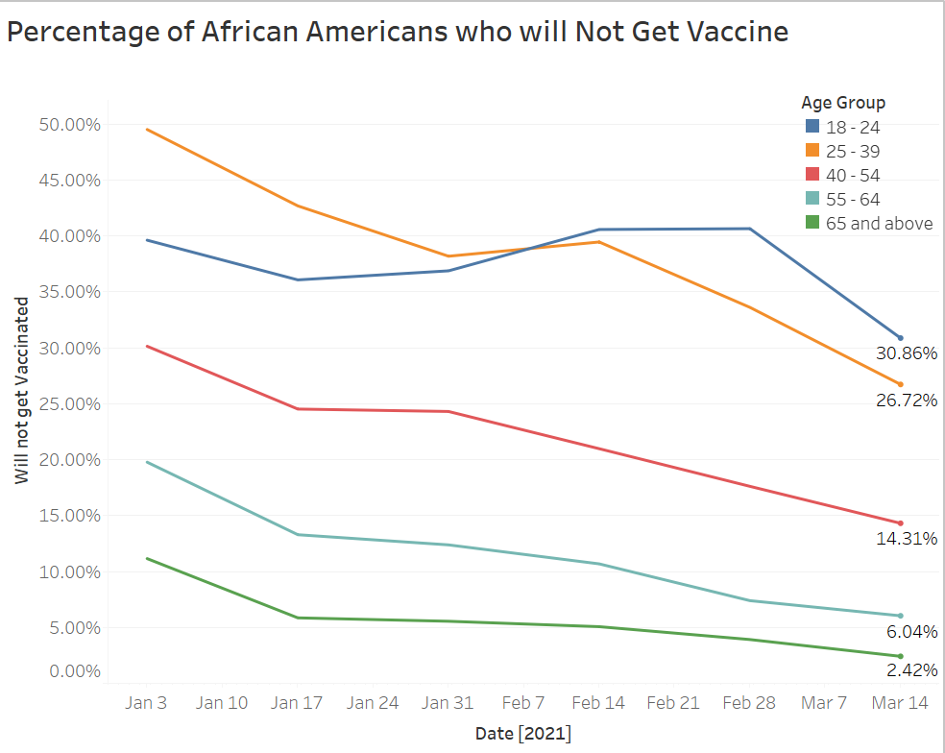
Specifically, Sentiment Among Black Americans Has Changed Most Drastically
Figure: Vaccine Sentiment for Black Americans by Age Group
This trend was apparent for Black Americans of all ages, but least prevalent among younger respondents (18-24).
Trends show that the ongoing outreach to black communities has help improve vaccination rates. However it differs by age, with young african americans not responding as well than the other age groups. We believe this trend will continue across demographic groups.
Notes:
We also observe that distrust in vaccines among Black Americans has changed most drastically over time.
Sources:
https://apnews.com/article/us-news-coronavirus-pandemic-bfabb2d3550141b74fac0080ce9226eb

Slide 13
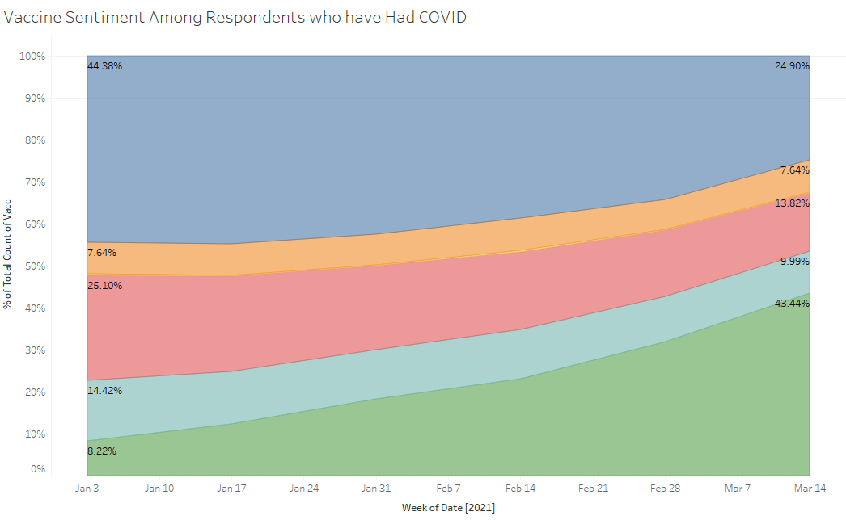
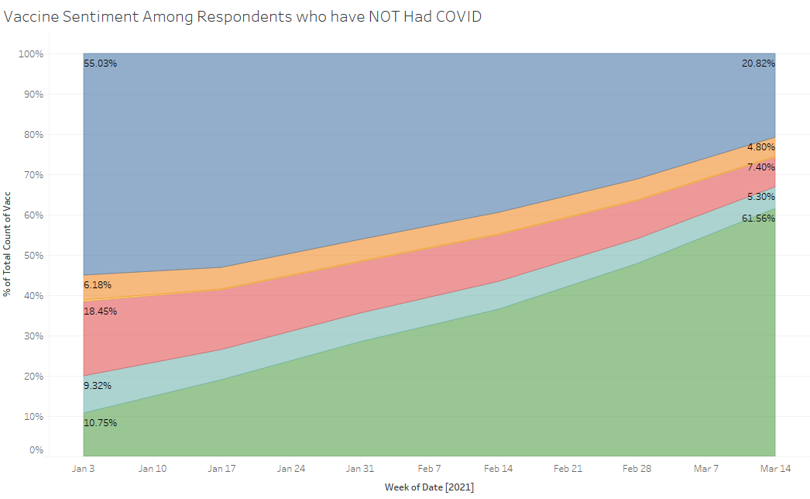
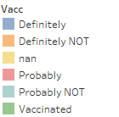
Had Covid vs. Not Had Covid
Figure 1: Vaccine Sentiment among Individuals who have had Covid
Figure 2: Vaccine Sentiment among Individuals who have NOT had Covid
Survey respondents who have had COVID are less likely to have been vaccinated or to take the vaccine.
Data Shown from January 1, 2021 to March 27, 2021
Notes:
We note that survey respondents who have had COVID are much less likely to have been vaccinated, and are much more likely to exhibit unwillingness to take the vaccine. As of the latest survey data: ~43% of respondents who have had COVID indicated that they had been vaccinated, as opposed to ~62% of people who have not had COVID.

Slide 14
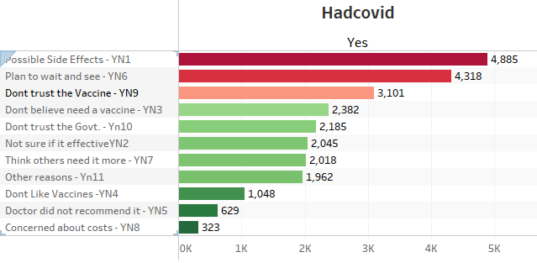
Deep Diving Within the HAD COVID Subgroup
People who already had COVID are afraid of possible side effects and plan to wait and see.
Interestingly, a high number of respondents also indicated that they Don’t Trust the Vaccine, or Don’t believe that they need a vaccine
Notes:
For those who have had Covid - many people did not trust the vaccine, or did not believe that they needed it. These went along with the common reasons to be unwilling to take the vaccine: concern over possible side effects, and planning to wait and see, which were prevalent across all analyzed subgroups.
We believe this could be due to believing that they had the antibodies to cope with the virus or lack of awareness of possible relapse

Slide 15
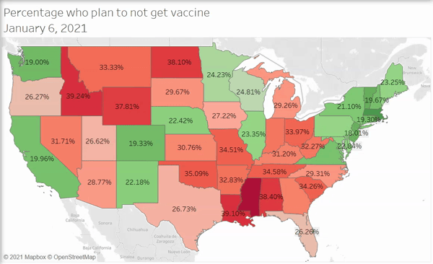
Unwillingness to get Vaccine has remained high in certain regions
In March ’21, within Mountain West states in US especially Wyoming, Idaho, North Dakota and Nebraska show the highest distrust
In Southern US, Alabama, Arkansas, Mississippi and Oklahoma exhibit a distrust in the vaccine that well exceeds the national average distrust of ~18%.
Data Shown from January 1, 2021 to March 27, 2021
Notes:
Here we discussed our findings in the difference in sentiment among geographical regions.
Unwillingness to take the vaccine among all states is decreasing over time.
However, several states in Central and Southern US where vaccine distrust runs high as of March 2021.

Slide 16
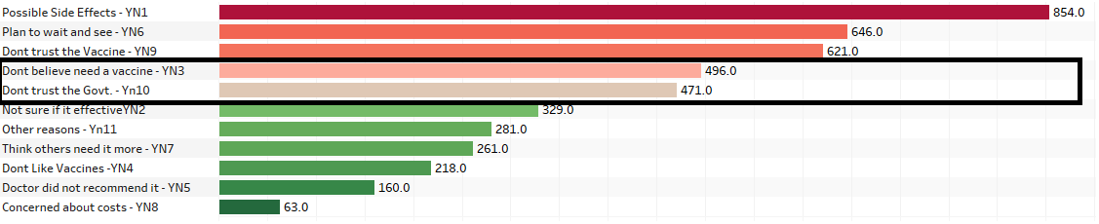
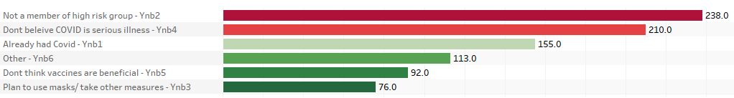
Though vaccine sentiment has improved, some states* continued to exhibit unwillingness to get vaccinated
Apart from the top 3 popular reasons among all groups, people in these smaller states either did not trust the Govt. or believed they did not need a vaccine
Their disbelief is mainly because they don’t identify as high risk groups or they do not believe in COVID.
*Data for Top 10 States include Wyoming, Mississippi, Nebraska, Idaho, North Dakota, Alabama, Arkansas, Alaska, Montana and Oklahoma in the week of 21st March ’21
Notes:
Above are the top 10 states which include Wyoming(23%), North Dakota,Idaho, Mississippi, Montana, Oklahoma, Alabama, Arkansas, Alaska and Nebraska which show some of the highest rates of refusing the vaccine.
When we look closer, we see a good portion of them either don’t believe they need it or don't trust the govt. We believe government outreach would have minimal effects in these
Implications of Our State Map: overall
We observe that vaccine sentiment across states is very different; those in the south, midwest, and mountain regions were more likely to distrust the vaccine, even as we moved into March 2021
Sparsely populated states showed more distrust with wyoming at highest 23% even in March ‘21
This led our group into our next analysis: which subgroups are less likely to take the vaccine? And after we’ve identified these subgroups, what reasons do they provide for distrusting the vaccine?
After identifying the reasons why these subgroups distrust the vaccine; what policy can we suggest to target these groups, to ultimately improve trust in the vaccine?

Slide 17
03
CONCLUSIONS
Policy recommendations for speedy recovery
Notes:
We provide recommendations based on our findings.

Slide 18
RECOMMENDATIONS
SUBGROUPS TO FOCUS
THOSE WHO ARE AFRAID OF SIDE EFFECTS
THOSE WHO PLAN TO WAIT AND SEE
COMMUNITY OUTREACH
Repondants who said they didn’t think they need the vaccine would be a much better target than respondents who don’t trust vaccines or the government. Reachout could include education and awareness on why all people regardless of age and health benefit from getting vaccinated
Widespread campaign that conveys the safety of the vaccine.
Widely publicize how prevalent the vaccine already is; if people know how many Americans have already been vaccinated, they will be more likely to get vaccinated themselves.
Promoting Bidens 100 day national vaccination outreach campaign could motivate more people to get vaccinated
Notes:
Based on our findings, we think it’s important to pivot more attention and resources to particular subgroups.
Unwillingness to be vaccinated is declining over time even for impacted subgroups.
Possible side effects and Planning to wait and see were two main reasons prevalent across all subgroups analyzed
Policymakers should create campaigns that address these common fears, and target them to all Americans.

Slide 19
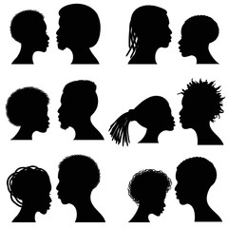
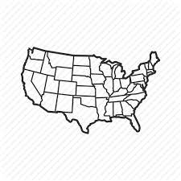

Prescription for Specific Subgroups
Black Americans:
Distrustful States:
Those who have already had Covid:
Continue outreach programs to Black Americans, as they have been proven to be successful in improving vaccine sentiment.
People from these states are distrustful of the vaccine mainly because they don’t identify as high risk groups or because they do not believe in COVID. Outreach programs should focus on educating residents of these states on the severity and social impacts of Covid-19.
Promote that even individuals who have had COVID require a vaccine.
Notes:
Based on our findings, we think it’s important to pivot more attention and resources to particular subgroups.

Slide 20
Potential Impacts
Multiplier effect
Potential reach
Economic impact
We not only protect the individual who got vaccinated but also protect the people around him/her. Eg. 1 teacher -> 22 students*
70% vaccinated population(195 million*) to reach herd immunity in the U.S.
As of 6 a.m. EDT April 23, a total of 91 million Americans had been fully vaccinated*
5.5+ million more people* from top 10 most distrustful states can be motivated.
The annual economic return on vaccinations has been estimated by the Global Alliance for Vaccines and Immunizations (GAVI) to be between 12% and 18%. *
Notes:
https://www.tapinto.net/articles/livingston-officials-expect-multiplier-effect-to-occur-as-teachers-get-vaccinated
https://www.mckinsey.com/industries/pharmaceuticals-and-medical-products/our-insights/covid-19-vaccines-meet-100-million-uncertain-americans
https://www.beckershospitalreview.com/public-health/states-ranked-by-percentage-of-population-vaccinated-march-15.html
https://www.census.gov/data/tables/time-series/demo/popest/2010s-state-total.html#par_textimage_1574439295 + 18% as distrustful
http://www.vaccinews.net/downloads/David%20E%20Bloom%20-%20The%20value%20of%20vaccination.pdf

Slide 21
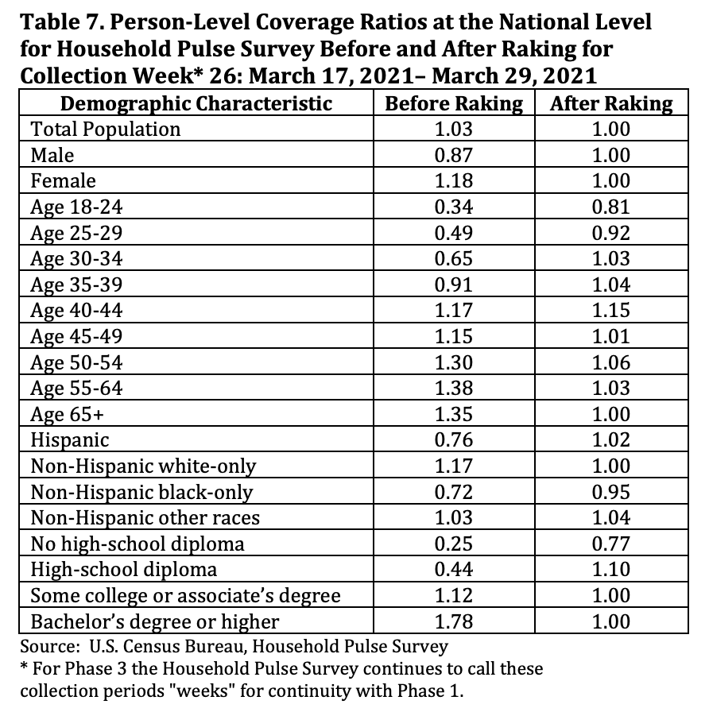
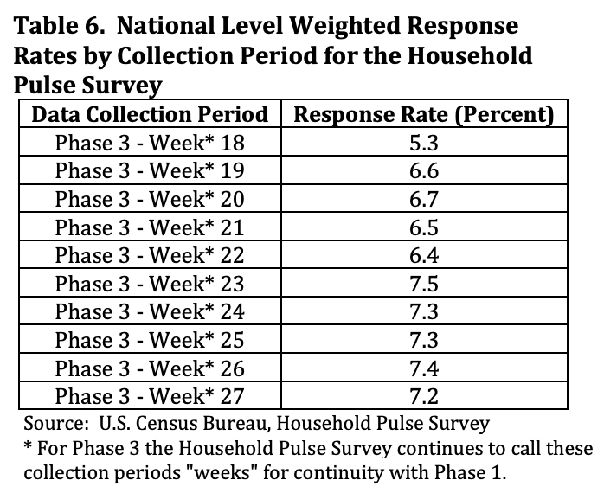
Potential Bias
Sampling Bias
Sample sizes were determined based on coefficient of variation (CV) selections, and readjusted for smaller areas. *
Undercoverage
Selection Bias
We were only able to analyze respondents who actually provided responses to COVID questions.
Nonresponse
Notes:
* Source: Sample sizes were determined such that a three percentage coefficient of variation (CV) for an estimate of 40 percent of the population would be achieved for all sample areas with the 1 Including the District of Columbia as a state. 3 exception of the 11 smallest states. In these smaller states, the sample size was reduced to produce a 3.5 percent CV. The overall sample sizes within the sampling areas were adjusted for an anticipated response rate of nine percent. For those counties in one of the top MSAs, the sampling interval was adjusted to select the higher of the sampling rate for either the state or MSA.

Slide 22
NEXT STEPS
PREDICT
PRESCRIBE
We aim to create a model that segments targeted groups based on whether they have low levels of vaccinations and whether we think outreach would be effective based off their responses.
Based on our model, we will identify the right amount of doses of vaccine needed at a particular time and location to avoid wastage. We can also identify specific regions or subgroups to which to target positive vaccine campaigns.
Notes:
Next steps in our analysis would be to create models for sentiment prediction for target groups, and provide prescriptive recommendations on outreach.

Slide 23
CONCLUSION
Consistent and comprehensive vaccine distribution is crucial for national and global recovery after months of research and contingency responses.
Policy makers should invest more resources in motivating people from subgroups with higher distrust to take the vaccine.
Notes:
We go over our primary takeaways from our project; that COVID-19 response is a collaborative effort, and that comprehensive policy is needed to address subgroups for which there is still prevailing distrust.

Slide 24
THANKS!

